Slide 1
Testing With Java

Slide 2
What is software testing?
A process that verifies and validates software functionality, performance, and quality to ensure it meets user requirements and works as intended.
Software testing is the process of checking if software satisfies its expectations.

Slide 3
Importance of testing in software development
Ensures Quality: Testing helps verify that the software meets the specified requirements and functions as intended.
Reduces Costs: Identifying and fixing bugs early in the development lifecycle is significantly cheaper than fixing them after the software is released.
Improves Performance: Testing helps determine and optimize the performance of the software, ensuring it can handle the intended workload.
Enhances Security: Testing can identify vulnerabilities in the software, helping to protect against potential security breaches.
Increases Customer Satisfaction: Delivering a high-quality, bug-free product leads to happier and more satisfied customers.
Facilitates Future Development: Thorough testing provides a solid foundation for adding new features and functionalities in the future.

Slide 4
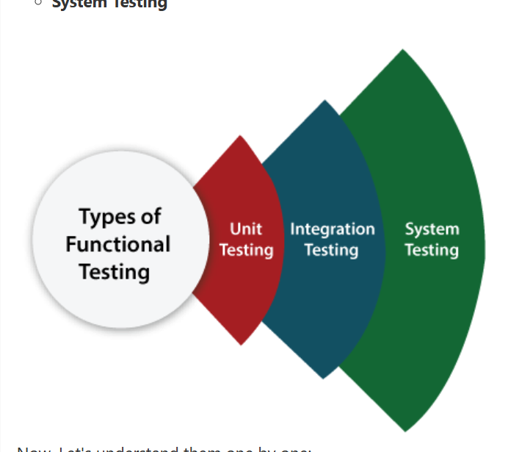
Types of testing (Unit, Integration, System)
G

Slide 5
Unit testing Java is a software testing technique where individual units or components of a Java program are tested in isolation to ensure they function as intended. The primary goal of unit testing is to verify that each function or method in a class performs correctly under various conditions application. A unit is the smallest testable part of any software.
Real-Life Example: Online Calculator App
Scenario:
You are developing an online calculator app with the following functions:
Addition
Subtraction
Multiplication
Division
Tools: JUnit, TestN

Slide 6
Integration testing is a type of software testing where individual units or components are combined and tested as a group. The purpose is to verify the interactions between different modules and ensure they work together as expected.
Real-Life Example: Online Food Delivery App
Components:
User Interface (UI) Module: Where users place orders.
Order Management System (OMS): Handles order processing.
Payment Gateway Module: Processes payments.
Delivery Management System: Manages deliveries.

Slide 7
What is System Testing?
System testing is a level of software testing where a complete and fully integrated software system is tested as a whole. The goal is to verify that the system meets the specified requirements and behaves correctly in all expected scenarios.
It is end-to-end testing and is usually performed after integration testing.
System Testing Scenario:
A user browses the app.
Selects food from a restaurant.
Places an order.
Makes payment via the payment gateway.
Receives order confirmation via email and SMS.
Tracks delivery status in the app.
Leaves feedback after order completion.

Slide 8
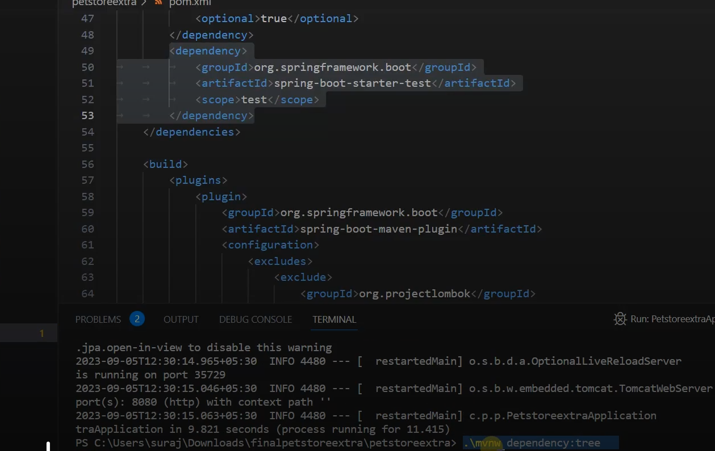

Slide 9
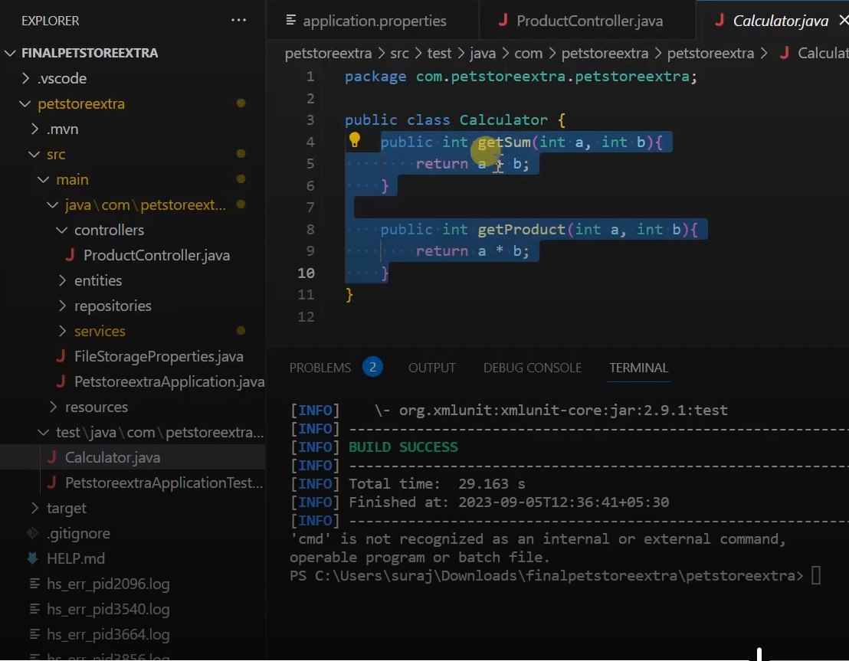

Slide 10
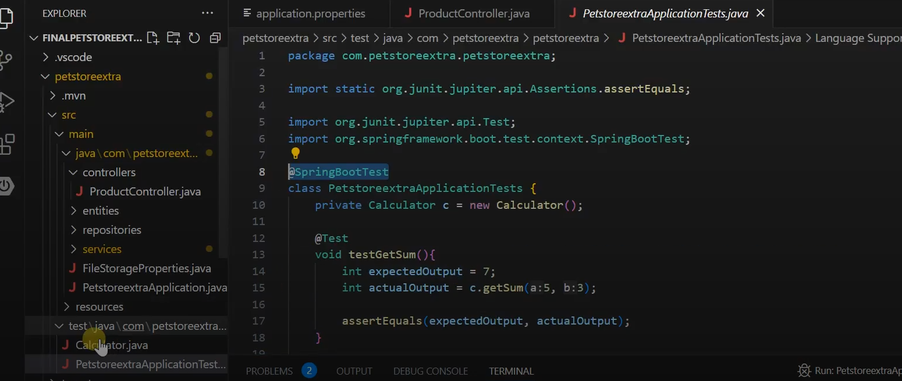

Slide 11
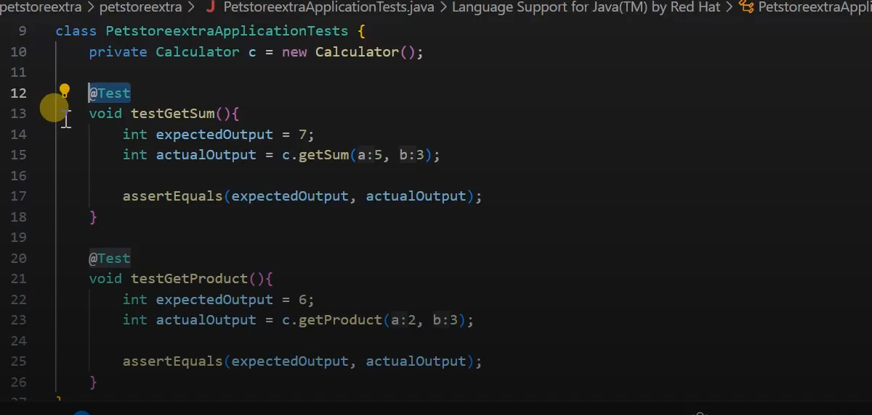

Slide 12
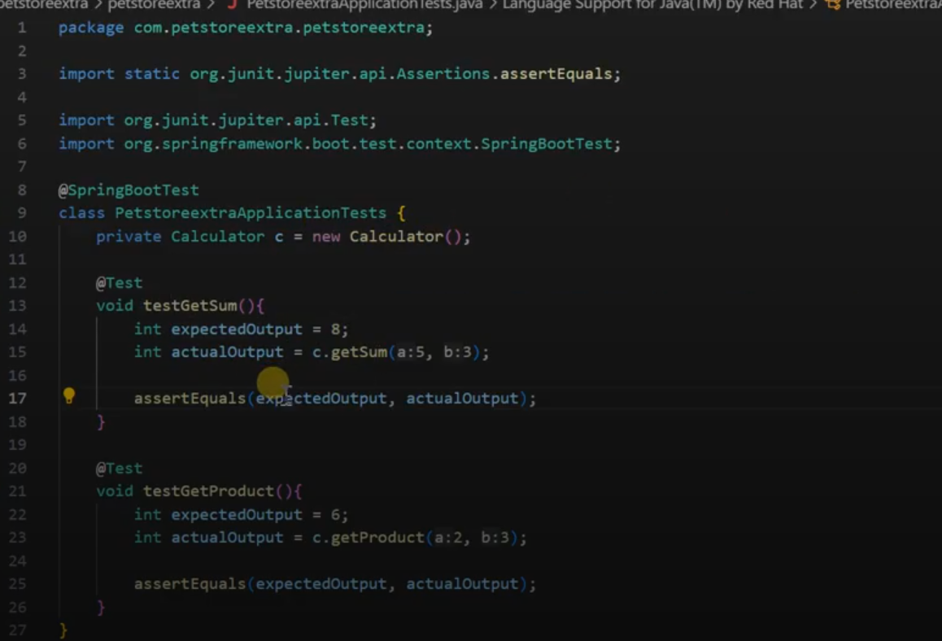

Slide 13
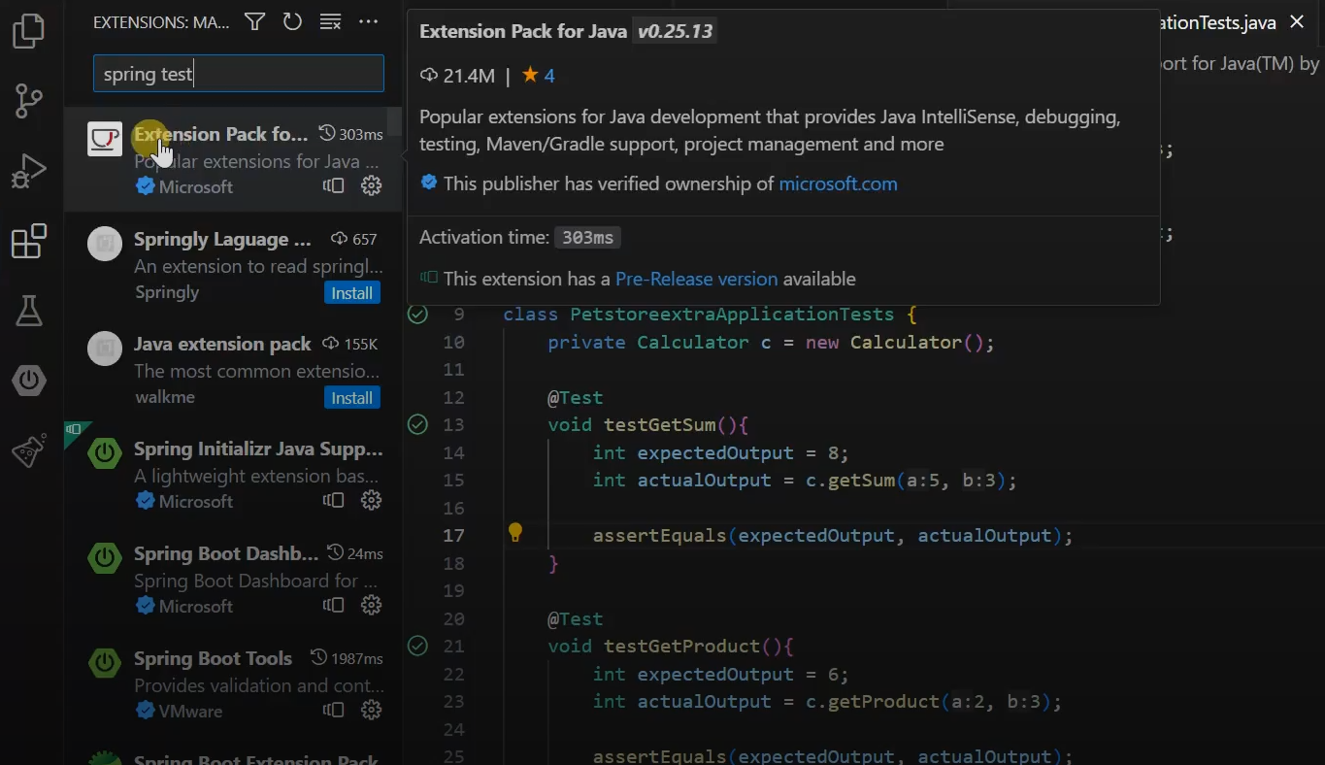

Slide 14
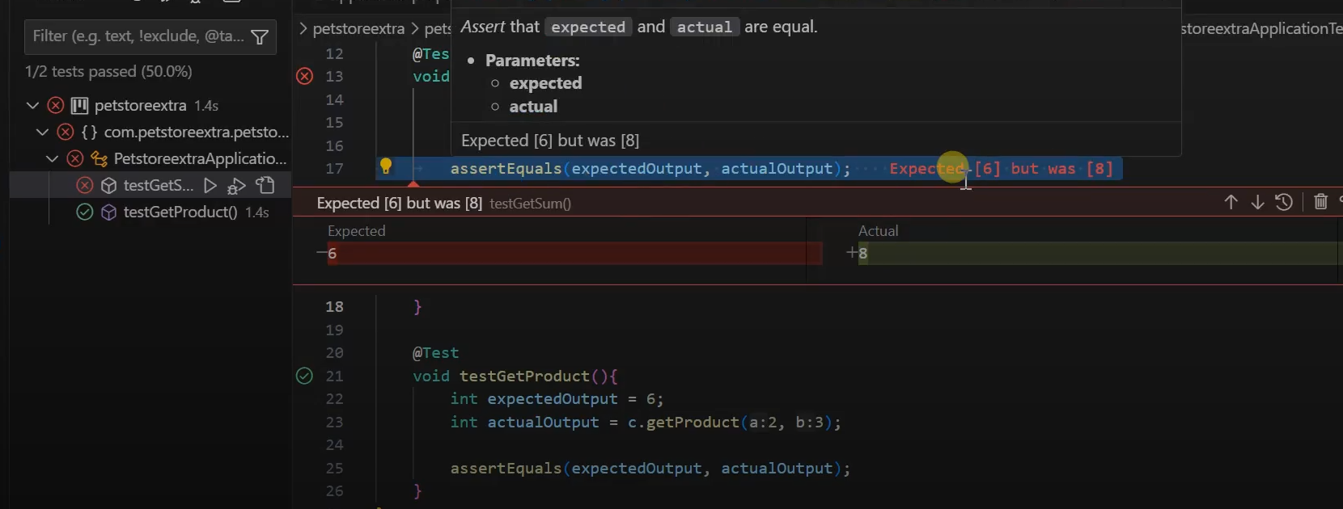

Slide 15
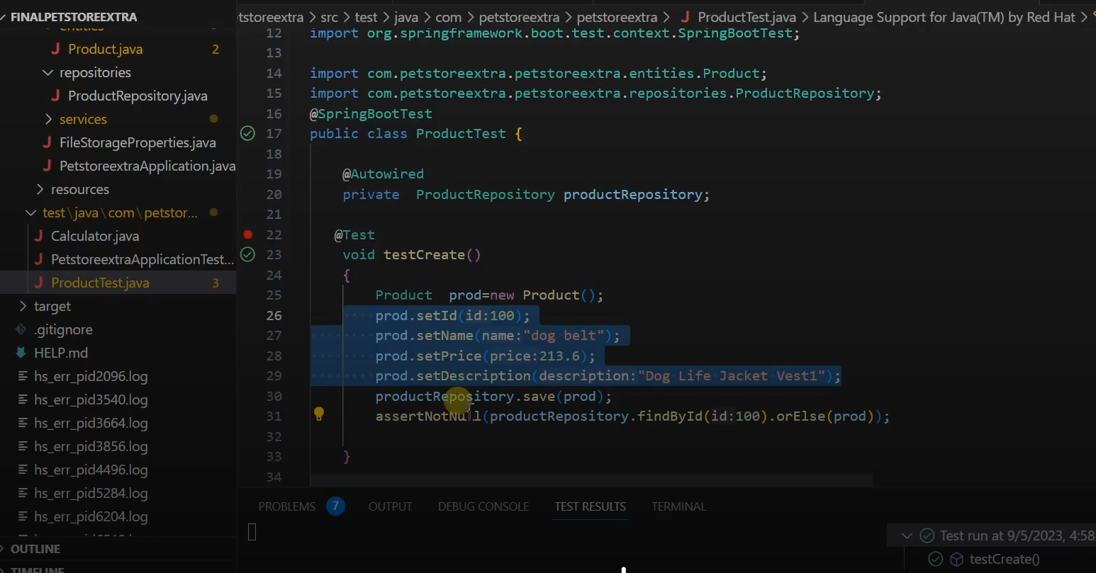

Slide 16
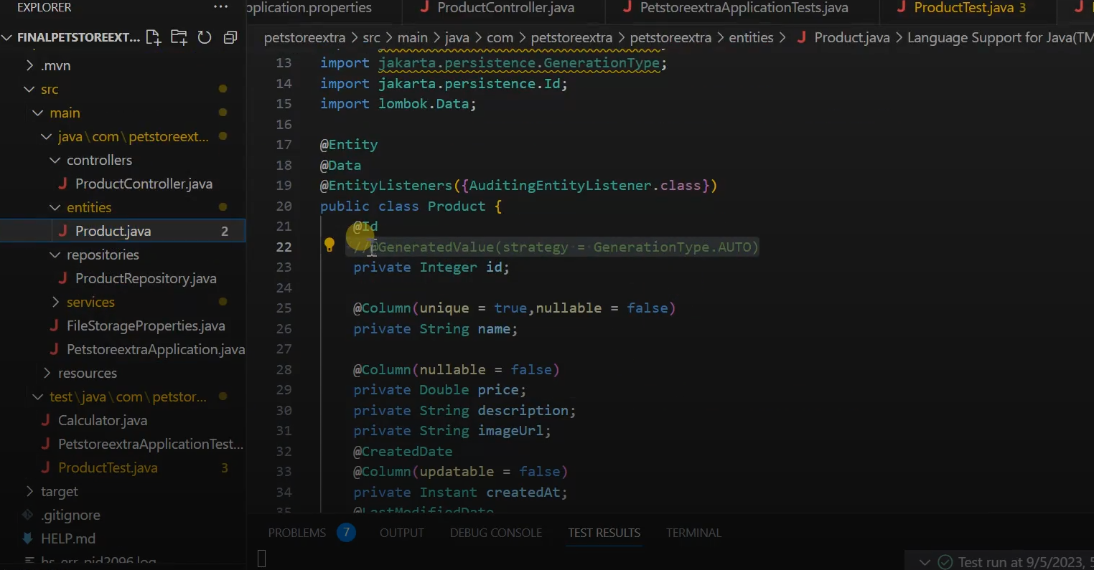
Comment the id property

Slide 17
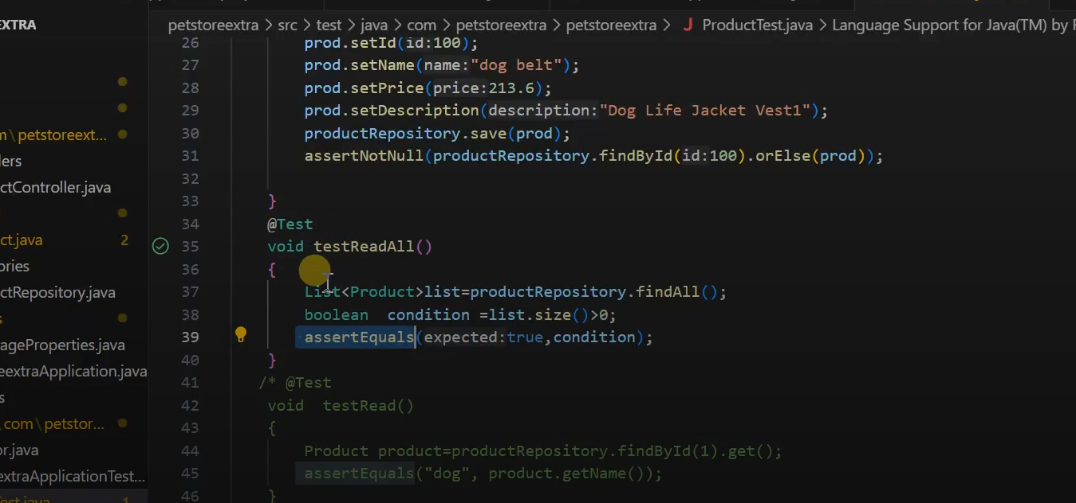

Slide 18
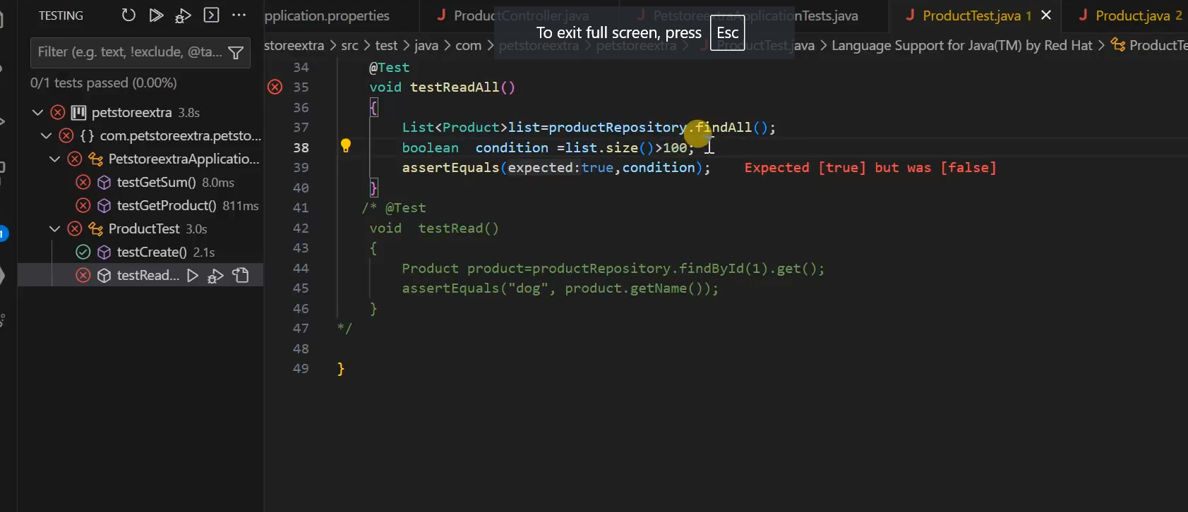
Test Case will be fail when value is >100 records

Slide 19
